Slide 1
Advanced Python Programming
Basic Software Development
Marco Prenassi
Laboratory of Data Engineering, Area Science Park
date

Slide 2
TABLE OF CONTENTS:
Why?
Basic software development concepts
Basic approaches to development
SECONDARY GOALS:
Work as a team

Slide 3
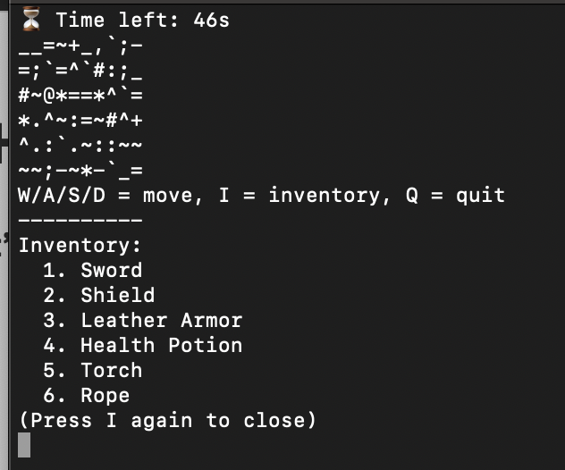
WHY?
- Let’s make a simple game
GITHUB:
git clone https://github.com/Master-Data-Management-and-Curation/Advanced-Python-2025.git

Slide 4
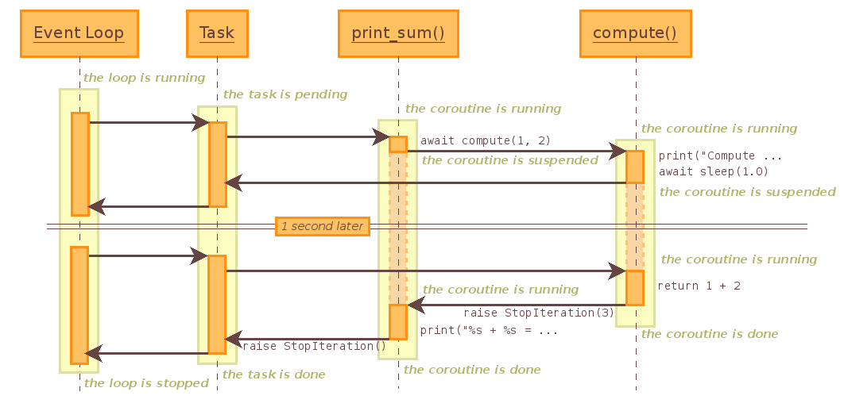
WHY?
Managing Events (1/2)
https://docs.python.org/id/3.5/library/asyncio-task.html

Slide 5
WHY?
Managing Events
DON’T PANIC
We will explore only one simple aspect of this, but it is important to understand the underlying problem
https://docs.python.org/id/3.5/library/asyncio-task.html

Slide 6
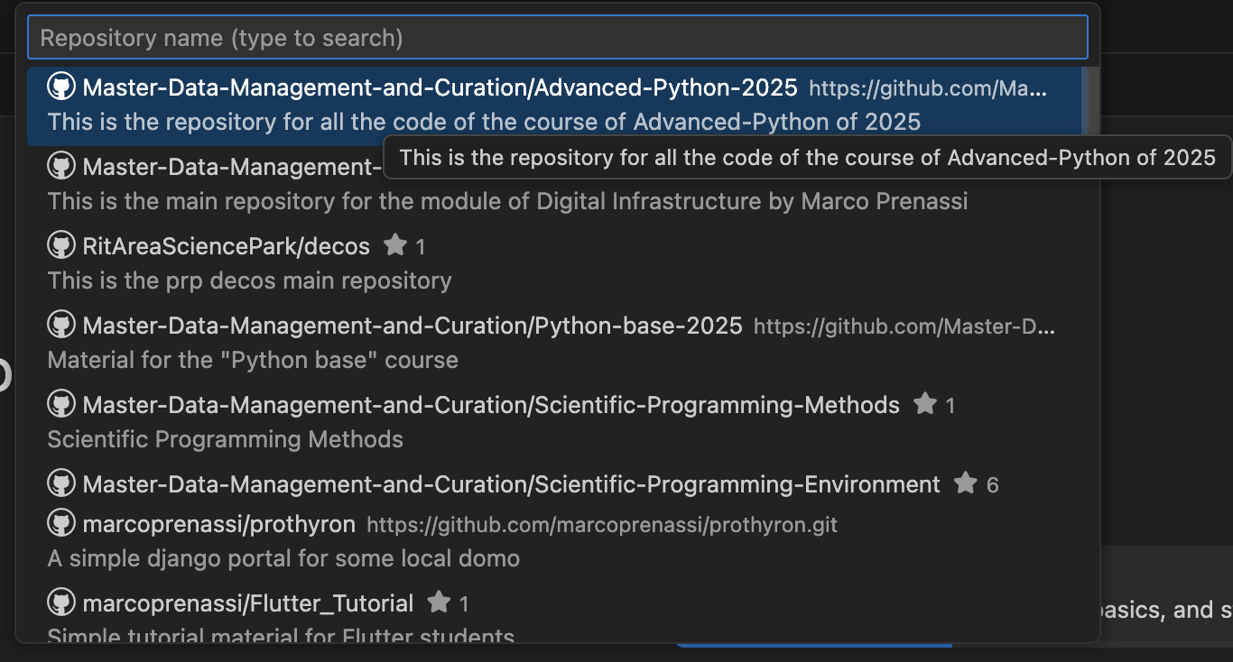

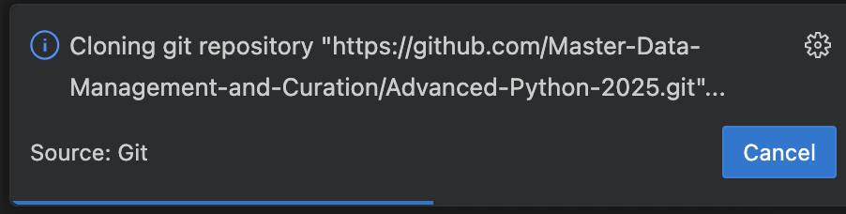
IDE: INTEGRATED DEVELOPMENT ENVIRONMENT
e.g., VISUAL STUDIO CODE
https://code.visualstudio.com/

Slide 7
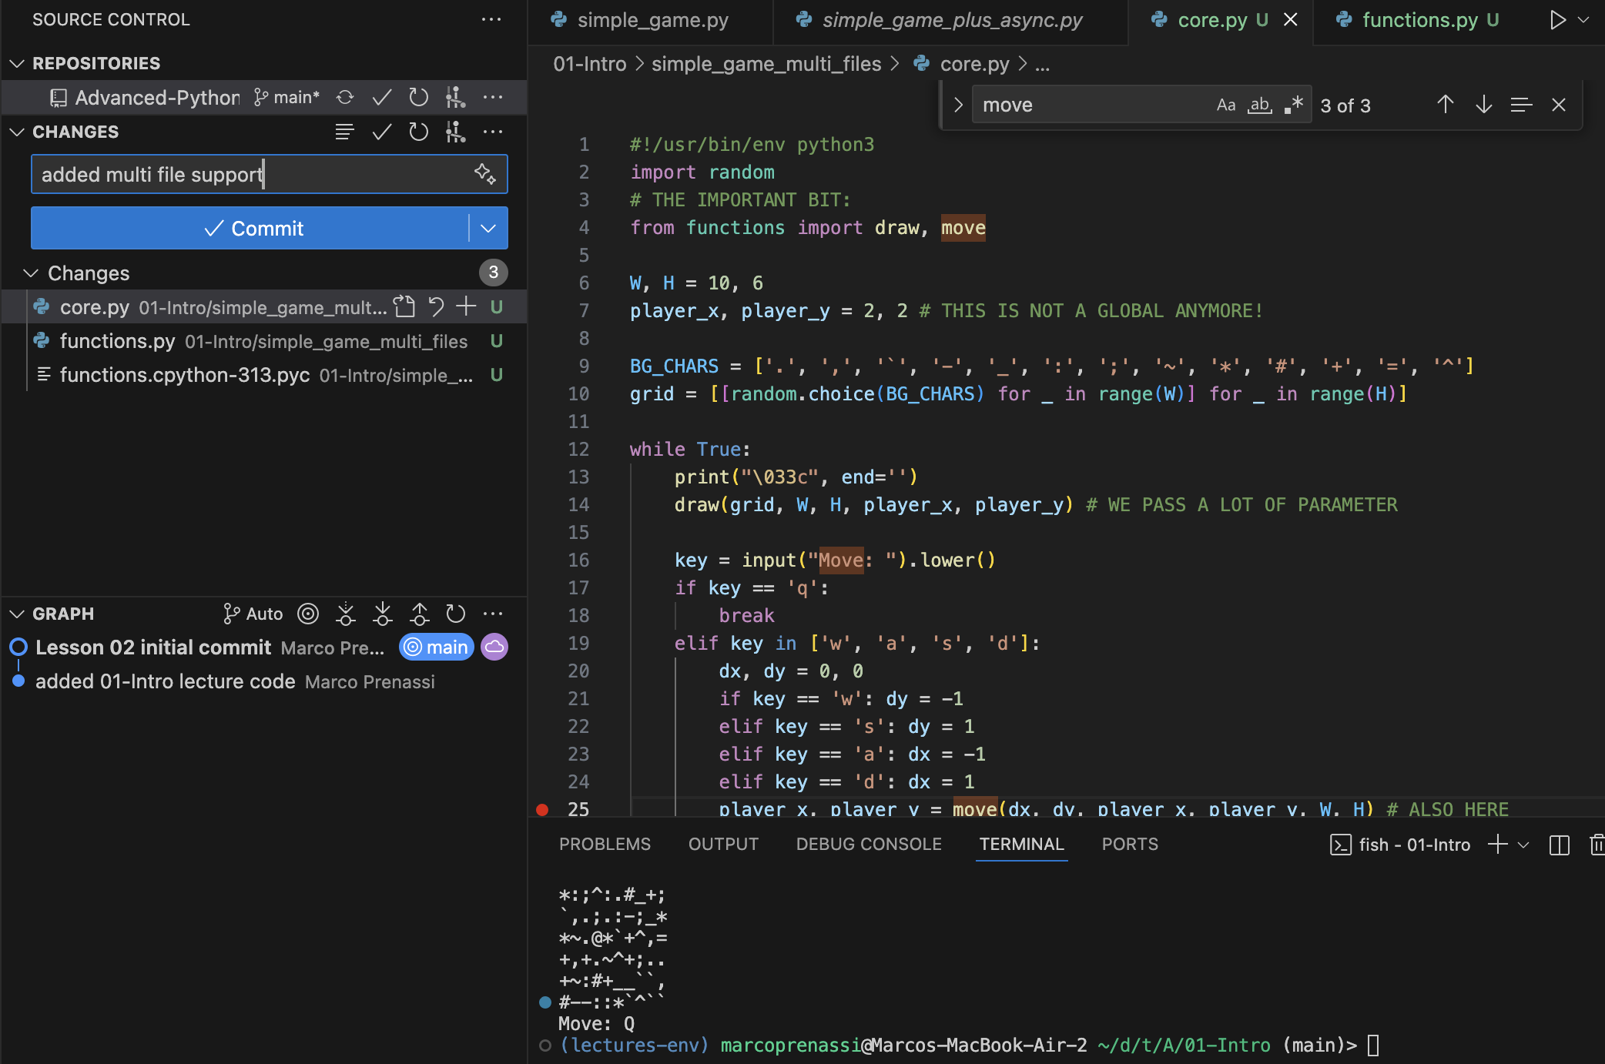
IDE: WHY
https://code.visualstudio.com/

Slide 8
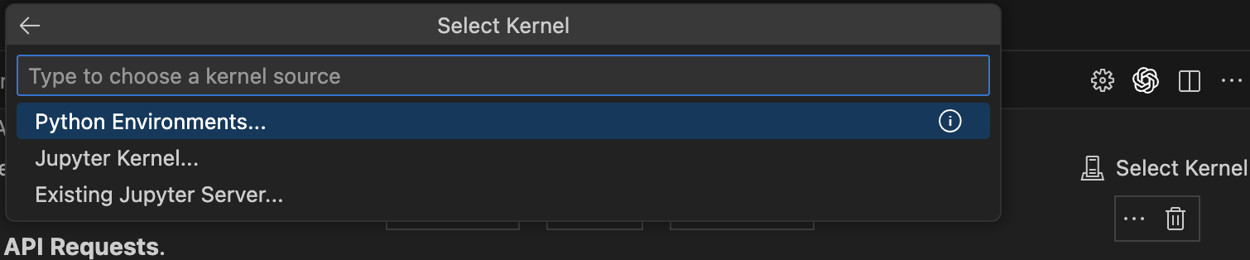
IDE: PYTHON and JUPYTER NOTEBOOKS
Create or activate the environment you want the kernel to use (in the folder of the repository) python3 -m venv lecture-env
source ./lecture-env/bin/activate
Install the kernel machinery in that env: pip install ipykernel
Register the kernel with Jupyter, giving it a recognizable name: python -m lecture-env install --user --name advanced-python-kernel --display-name "Advanced Python Kernel"
Restart VSCODE, open a jupyter notebook and then select:
2.
1.
https://code.visualstudio.com/

Slide 9
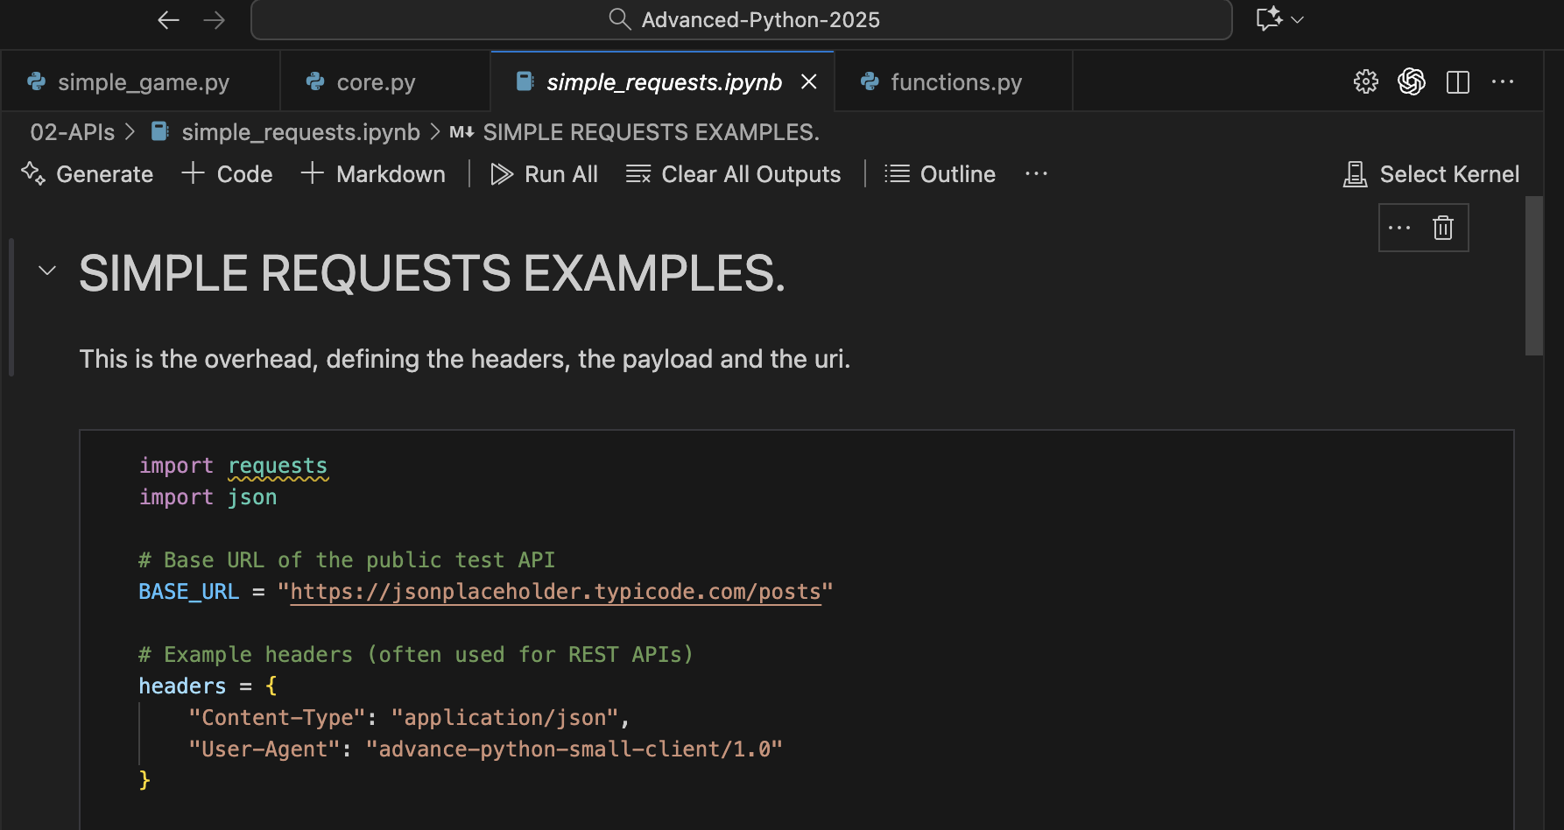
IDE: PYTHON and JUPYTER NOTEBOOKS
https://code.visualstudio.com/

Slide 10



MANAGING EVENTS
INTRODUCING THE ACTORS
APPLICATION PROGRAMMING INTERFACES
(API)
MACHINEs
PAN-LAN
… a lot of different protocols
USER INTERFACES
(UI)
CODE
COMPILED ACTING on a PROCESSING SYSTEM (RUNTIME)
HTTP REQUESTS
PEOPLE
or ANIMALS
INTERNET

Slide 11
MANAGING EVENTS
INTRODUCING THE ACTORS
APPLICATION PROGRAMMING INTERFACES
(API)
MACHINEs
PAN-LAN
WE WILL FOCUS
ON APIs HTTP REQUESTS with REST
… a lot of different protocols
USER INTERFACES
(UI)
CODE
COMPILED ACTING on a PROCESSING SYSTEM (RUNTIME)
HTTP REQUESTS
PEOPLE
or ANIMALS
INTERNET

Slide 12


HTTP PROTOCOL BASIC CONCEPTS
HTTP (HyperText Transfer Protocol) is standard application-level protocol used for exchanging files on the World Wide Web.
HTTP runs on top of the TCP/IP protocol and (later) on the QUIC protocol. Web browsers are HTTP clients that send file requests to Web servers, which in turn handle the requests via an HTTP service.
STATELESS!!
EVERY REQUEST IS NOT DEFINED BY THE PREVIOUS ONE
1. REQUEST
2. RESPONSE
https://www.britannica.com/technology/HTTP

Slide 13
HTTP REQUESTS
An HTTP request has four main parts:
Method (Type): what action to perform
URL (Endpoint): what resource to act on
Headers: extra info about the request (e.g., Authorization)
Body (Payload): data sent to the server (if needed, remember, these are REQUESTS)
Request method | RFC | Request has payload body | Response has payload body
GET | RFC 9110 | Optional | Yes
HEAD | RFC 9110 | Optional | No
POST | RFC 9110 | Yes | Yes
PUT | RFC 9110 | Yes | Yes
DELETE | RFC 9110 | Optional | Yes
CONNECT | RFC 9110 | Optional | Yes
OPTIONS | RFC 9110 | Optional | Yes
TRACE | RFC 9110 | No | Yes
PATCH | RFC 5789 | Yes | Yes
e.g.,
1. POST /api/users HTTP/1.1
2. Host: api.example.com
3. Content-Type: application/json
4. { "name": ”John", "role": ”researcher" }
https://en.wikipedia.org/wiki/HTTP

Slide 14
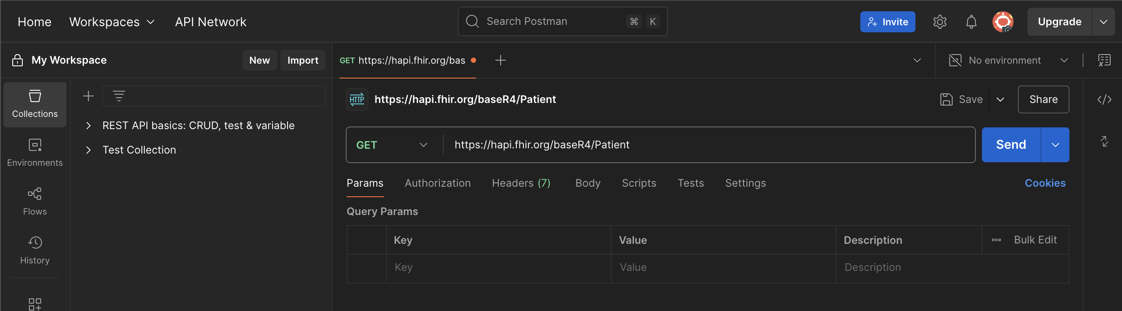
HTTP REQUESTS – LET’S TRY
HOW:
CURL (UNIX or WINDOWS ALIAS)
REQUESTS MODULE IN PYTHON
POSTMAN
… MANY MORE
POSTMAN (https://web.postman.co/home):
CURL:
Unix (macOs + Linux):
curl --method GET -H "Accept: application/fhir+json" https://hapi.fhir.org/baseR4/Patient/example
Windows powershell:
Invoke-RestMethod -Uri "https://hapi.fhir.org/baseR4/Patient/example" -Method GET -Headers @{ "Accept" = "application/fhir+json" } (In a single line!!!)

Slide 15
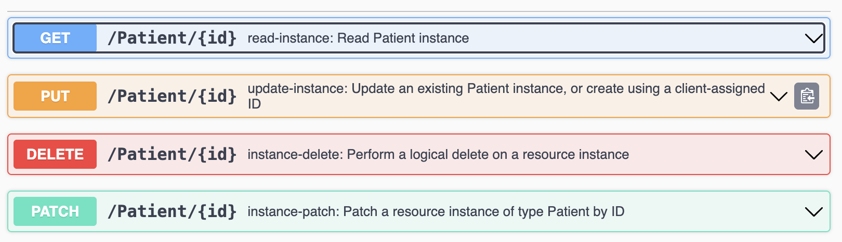
HTTP REQUESTS - SWAGGER
Swagger:
https://hapi.fhir.org/baseR4/swagger-ui/
Swagger allows you to describe the structure of your APIs so that machines can read them. The ability of APIs to describe their own structure is the root of all awesomeness in Swagger.
from https://swagger.io/docs/specification/v2_0/what-is-swagger/

Slide 16
HTTP REQUESTS – RESPONSE CODES
1xx | 2xx STATUS CODES | 3xx | 4xx CLIENT ERRORS | 5xx SERVER ERRORS
 | 200 Ok 201 Accepted … |  | 400 Bad Request 401 Unauthorized … 403 Forbidden 404 Not Found … 418 I'm a teapot … | 500 Internal Server Error … 502 Bad Gateway 503 Service Unavailable …
https://en.wikipedia.org/wiki/HTTP

Slide 17
HTTP REQUESTS – RESPONSE CODES
LET’S TRY SOMETHING SIMPLE WITH: 02-APIs/simple_requests.ipynb
snippets of code:
Create custom headers:
headers = {
"Authorization": "Bearer your_api_token", "Content-Type": "application/json",
"User-Agent": "Python-Requests/Example"
}
Data to send with the POST request:
post_data = { "key1": "value1", "key2": "value2" }
Perform the POST request :
try:
post_response = requests.post(post_url, json=post_data, headers=headers)
print(f"Status Code: {post_response.status_code}")
print(f"Response Body: {post_response.json()}")
except requests.RequestException as e:
print(f"Error during POST request: {e}")
https://en.wikipedia.org/wiki/HTTP

Slide 18

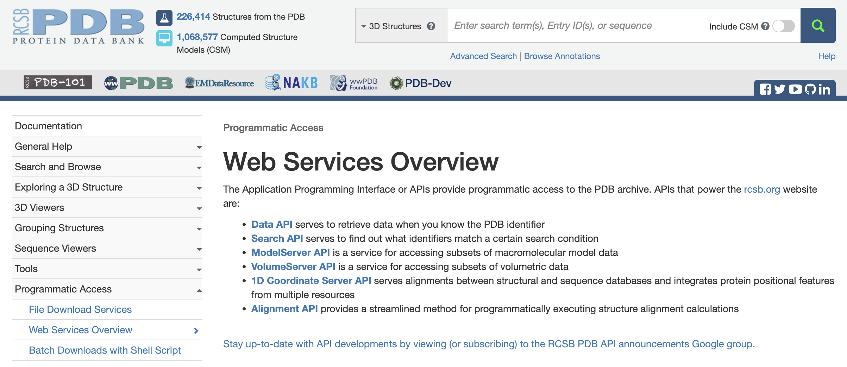
HTTP REQUESTS – LET’S TRY ON SOMETHING REAL
LET’S START WITH RCSB
Mapping data
https://www.rcsb.org/

Slide 19
HTTP REQUESTS – LET’S TRY ON SOMETHING REAL
LET’S START WITH RCSB
and jupyter notebooks on
02-APIs/RCSB_Mapping.ipynb
https://www.rcsb.org/

Slide 20
RESTful
Uniform interface: One piece of data belong to a single URI
Client-server decoupling: You only need to know the URI of the server to interact
Statelessness: all the information to process is included in the message, no previous operations required
Cacheability: everything that is cacheable must be cached, to improve performance (client AND server side)
Layered system architecture: the architecture is transparent to the layers inside
Code on demand*: could give runnable code as a response (this is risky and must be done only on-demand).
https://www.rcsb.org/

Slide 21
SOAP vs REST
Simple Object Access Protocol (SOAP)! → POST ← GET, xml is an envelope
HTTP POST /ReturnValue HTTP/1.0 Host: www.abc.net Content-Type: text/xml; charset = utf-8 Content-Length: nnn
<?xml version = "1.0"?> <SOAP-ENV:Envelope xmlns:SOAP-ENV = "http://www.w3.org/2001/12/soap-envelope"
SOAP-ENV:encodingStyle = "http://www.w3.org/2001/12/soap-encoding">
<SOAP-ENV:Body xmlns:m = "http://www.abc.net/values"> <m:Value> <m:ValueName>Temperature</m:ValueName> </m:GetValue> </SOAP-ENV:Body>
</SOAP-ENV:Envelope>
HTTP/1.0 200 OK Content-Type: text/xml; charset = utf-8 Content-Length: nnn
<?xml version = "1.0"?> <SOAP-ENV:Envelope xmlns:SOAP-ENV = "http://www.w3.org/2001/12/soap-envelope"
SOAP-ENV:encodingStyle = "http://www.w3.org/2001/12/soap-encoding">
<SOAP-ENV:Body xmlns:m = "http://www.abc.net/values"> <m: ValueResponse > <m: Value >25.0</m: Value>
</m: ValueResponse > </SOAP-ENV:Body>
</SOAP-ENV:Envelope>
How to “move fast”: HTTP GET http://www.abc.net?value=temperature -> Response…
https://www.rcsb.org/
With RESTful: HTTP GET http://www.abc.net/values/temperature -> 25.0 (in JSON: {“temperature”: 25.0})
also: let’s use all the commands available in HTTP

Slide 22
WHY?
- Let’s make a simple game
GITHUB:
git clone …

Slide 23
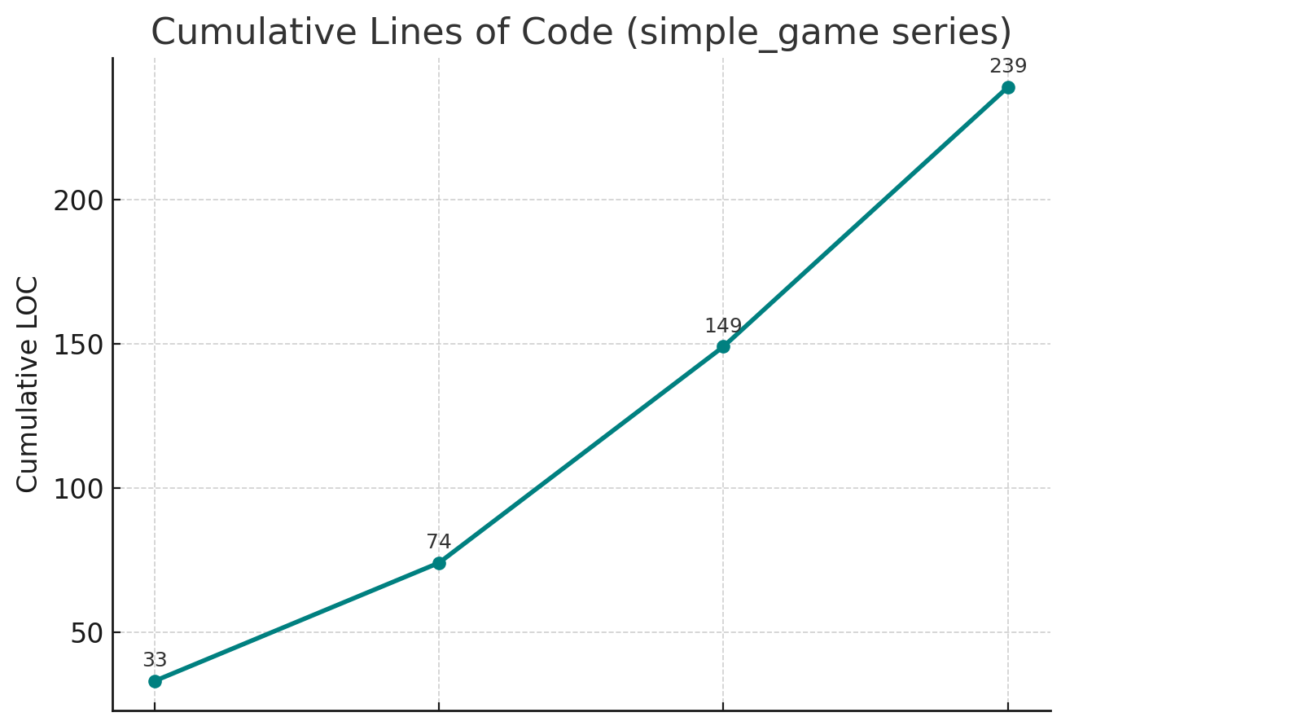
WHY?
- Lines Of Codes (LOC) growth by feature:

Slide 24
WHY?
Managing complexity (2/2)
Object-Oriented Programming (OOP)
Organizes code around objects that combine data and behaviour; promotes encapsulation and reuse.
Functional Programming (FP)
Builds programs from pure, stateless functions and immutable data.
Data-Oriented Design (DOD)
Focuses on data layout and usage patterns for clarity and performance.
Entity-Component-System (ECS)
Composes entities from independent data components and processing systems.
Procedural / Modular Programming
Structures programs as reusable functions grouped into modules.
Declarative Programming
Describes what to do, leaving the how to the underlying system.
Actor Model
Uses independent actors that communicate via messages to handle concurrency safely.
Reactive Programming
Represents logic as data streams that automatically propagate changes.
Aspect-Oriented Programming (AOP)
Isolates cross-cutting concerns like logging or security into separate aspects.
Agent-Based Systems
Models systems as interacting autonomous agents with their own goals.
Dataflow Programming
Defines computation as a directed graph of data dependencies and transformations.
THESE ARE NOT ENEMIES
MULTI-PARADIGM
is THE NORM

Slide 25
WHY?
Managing complexity
Object-Oriented Programming (OOP)
Organizes code around objects that combine data and behaviour; promotes encapsulation and reuse.
Functional Programming (FP)
Builds programs from pure, stateless functions and immutable data.
Data-Oriented Design (DOD)
Focuses on data layout and usage patterns for clarity and performance.
Entity-Component-System (ECS)
Composes entities from independent data components and processing systems.
Procedural / Modular Programming
Structures programs as reusable functions grouped into modules.
Declarative Programming
Describes what to do, leaving the how to the underlying system.
Actor Model
Uses independent actors that communicate via messages to handle concurrency safely.
Reactive Programming
Represents logic as data streams that automatically propagate changes.
Aspect-Oriented Programming (AOP)
Isolates cross-cutting concerns like logging or security into separate aspects.
Agent-Based Systems
Models systems as interacting autonomous agents with their own goals.
Dataflow Programming
Defines computation as a directed graph of data dependencies and transformations.
THESE ARE NOT ENEMIES
MULTI-PARADIGM
is THE NORM

Slide 26
“OPERATOR OVERLOAD” in PYTHON
Operator | Method Name | Usage Example
+ | __add__(self, other) | a + b
- | __sub__(self, other) | a - b
* | __mul__(self, other) | a * b
/ | __truediv__(self, other) | a / b
== | __eq__(self, other) | a == b
len() | __len__(self) | len(obj)
[] | __getitem__(self, key) | obj[key]
in | __contains__(self, item) | item in obj
str() | __str__(self) | print(obj)
repr() | __repr__(self) | repr(obj)
call() | __call__(self, *args) | obj()
del | __del__(self) | del obj
Dunder Methods
special “magic” functions like __init__, __str__, __add__ — they define how objects behave with Python’s built-in syntax.
called automatically at runtime, never by the compiler.
Operator Overloading
in python “overloading” means redefining what +, >, ==, etc. do for your objects through dunder methods.
Remember: Python is “simple”, nothing happens at compile time, every operator is just a function call under the hood.

Slide 27


OBJECT ORIENTED PROGRAMMING
WHY IS IT USED SO MUCH?
OBJECT-ORIENTED PARADIGM
CLASS
OBJECT
OOP
ATTRIBUTES
METHODS

Slide 28
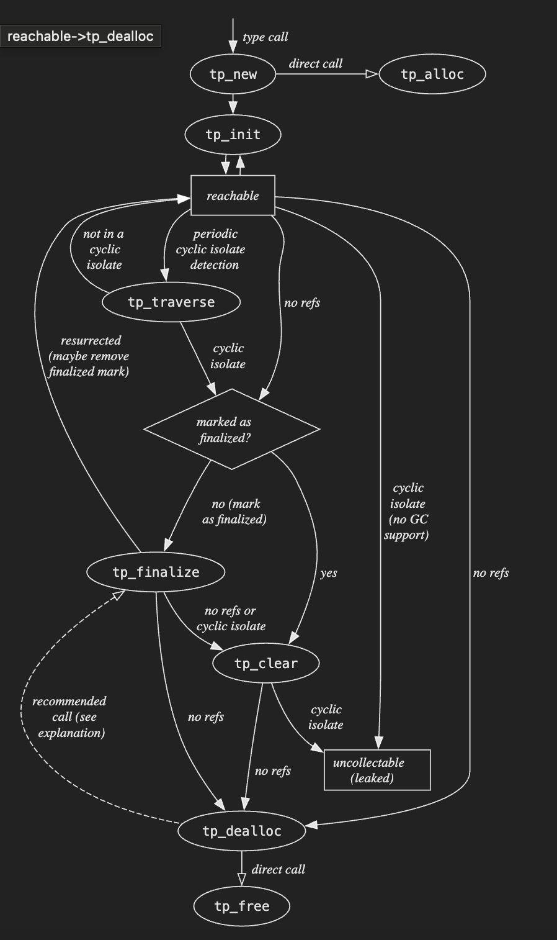
OBJECT LIFECYCLE in PYTHON
object.__new__(cls[, ...])
Called to create a new instance of class cls. __new__() is a static method (special-cased so you need not declare it as such) that takes the class of which an instance was requested as its first argument. The remaining arguments are those passed to the object constructor expression (the call to the class). The return value of __new__() should be the new object instance (usually an instance of cls). […]
object.__init__(self[, ...])
Called after the instance has been created (by __new__()), but before it is returned to the caller. The arguments are those passed to the class constructor expression. If a base class has an __init__() method, the derived class’s __init__() method, if any, must explicitly call it to ensure proper initialization of the base class part of the instance; for example: super().__init__([args...]). […]
object.__del__(self)
Called when the instance is about to be destroyed. This is also called a finalizer or (improperly) a destructor. If a base class has a __del__() method, the derived class’s __del__() method, if any, must explicitly call it to ensure proper deletion of the base class part of the instance. […]
class Overload_Me:
def __new__(cls): print("Creating instance");
return super().__new__(cls)
def __init__(self): print("Initializing instance")
def __del__(self): print("Destroying instance")
overload_me_object = Overload_Me()
del overload_me_object
https://docs.python.org/3/c-api/lifecycle.html

Slide 29
OBJECT AND CLASSES BASIC PROPERTIES
Encapsulation
Abstraction
Inheritance
Polymorphism

Slide 30
OBJECT AND CLASSES BASIC PROPERTIES
EVERYTHING IS CONTAINED INSIDE AN OBJECT
Encapsulation

Slide 31



OBJECT AND CLASSES BASIC PROPERTIES
THE FUNCTION COULD BE DESCRIBED REGARDLESS OF THE IMPLEMENTATION
Abstraction
IF I NEED A FUNCTION TO TALK TO PEOPLE OVER LONG DISTANCES
Uberprutser - Own work
CC BY-SA 3.0
File:FTTR RTT56B Telephone 2.jpg
Created: 16 December 2012
Uploaded: 17 December 2012
Gustavo Belemmi - Own work
CC BY-SA 4.0
File:Antique toy walkie-talkie.jpg
Created: 13 July 2021
Uploaded: 14 July 2021
© Raimond Spekking / CC BY-SA 4.0 (via Wikimedia Commons)
CC BY-SA 4.0
File:Dell Streak-9014.jpg
Created: 22 June 2020
Uploaded: 28 June 2020

Slide 32
OBJECT AND CLASSES BASIC PROPERTIES
I CAN EXTEND THE FUNCTIONALITIES OF A CLASS
Inheritance

Slide 33
OBJECT AND CLASSES BASIC PROPERTIES
I CAN OVERRIDE THE FUNCTIONALITIES OF A CLASS
Polymorphism

Slide 34
WORKING TOGETHER – DEFINE CLASSES WITHOUT CODE
CLASS
CLASS
METHOD SIGNATURE
METHOD SIGNATURE
METHOD SIGNATURE:
def NAME(param1: type, param2: type, …)-> return type
Brief description:
What this function does.

Slide 35
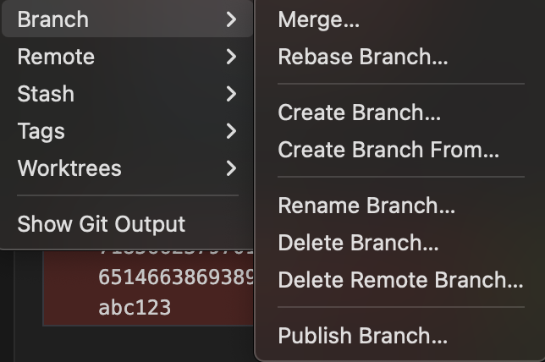
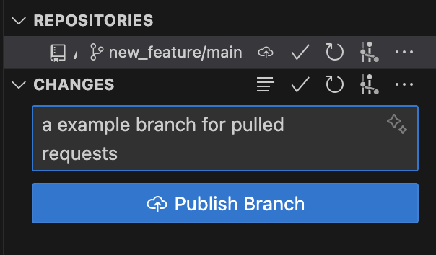
WORKING TOGETHER – GIT PULLING REQUESTS
1. CREATE A NEW BRANCH FROM THE MAIN
CALL IT LIKE new_feature/category

Slide 36
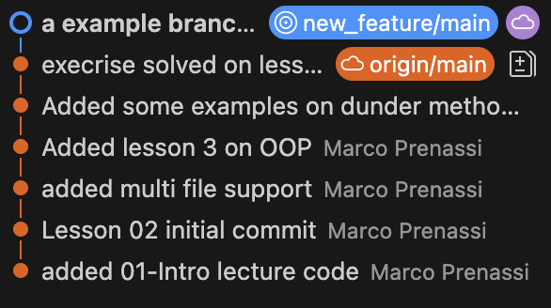
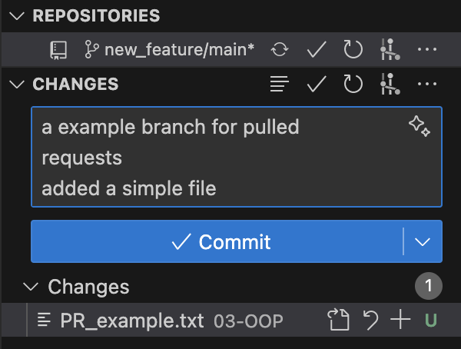
WORKING TOGETHER – GIT PULLING REQUESTS
2. CHECKOUT IN THAT BRANCH, create/edit
and TEST the new branch and then COMMIT and PUSH!

Slide 37
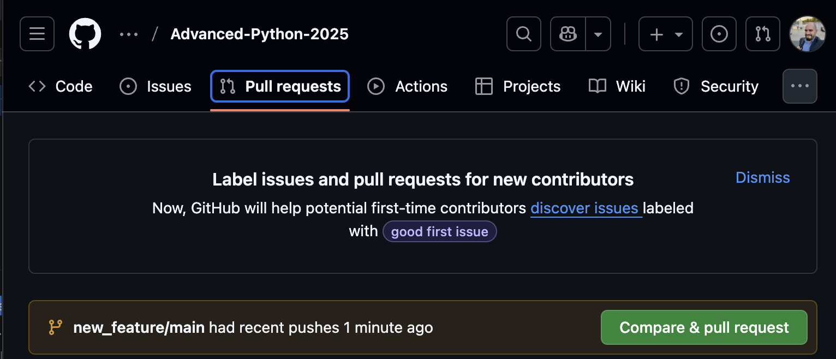
WORKING TOGETHER – GIT PULLING REQUESTS
2. In github you get a notification of the branch, you can do “Compare and send a Pull request”

Slide 38
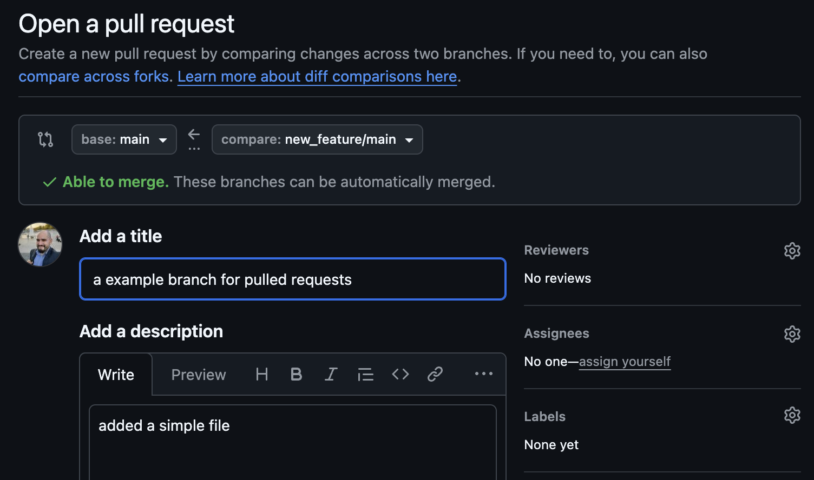
WORKING TOGETHER – GIT PULLING REQUESTS
2. In github you get a new Pull request, compare it and
check if there are some merge issue.

Slide 39
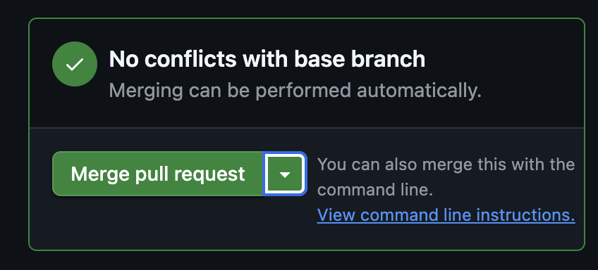
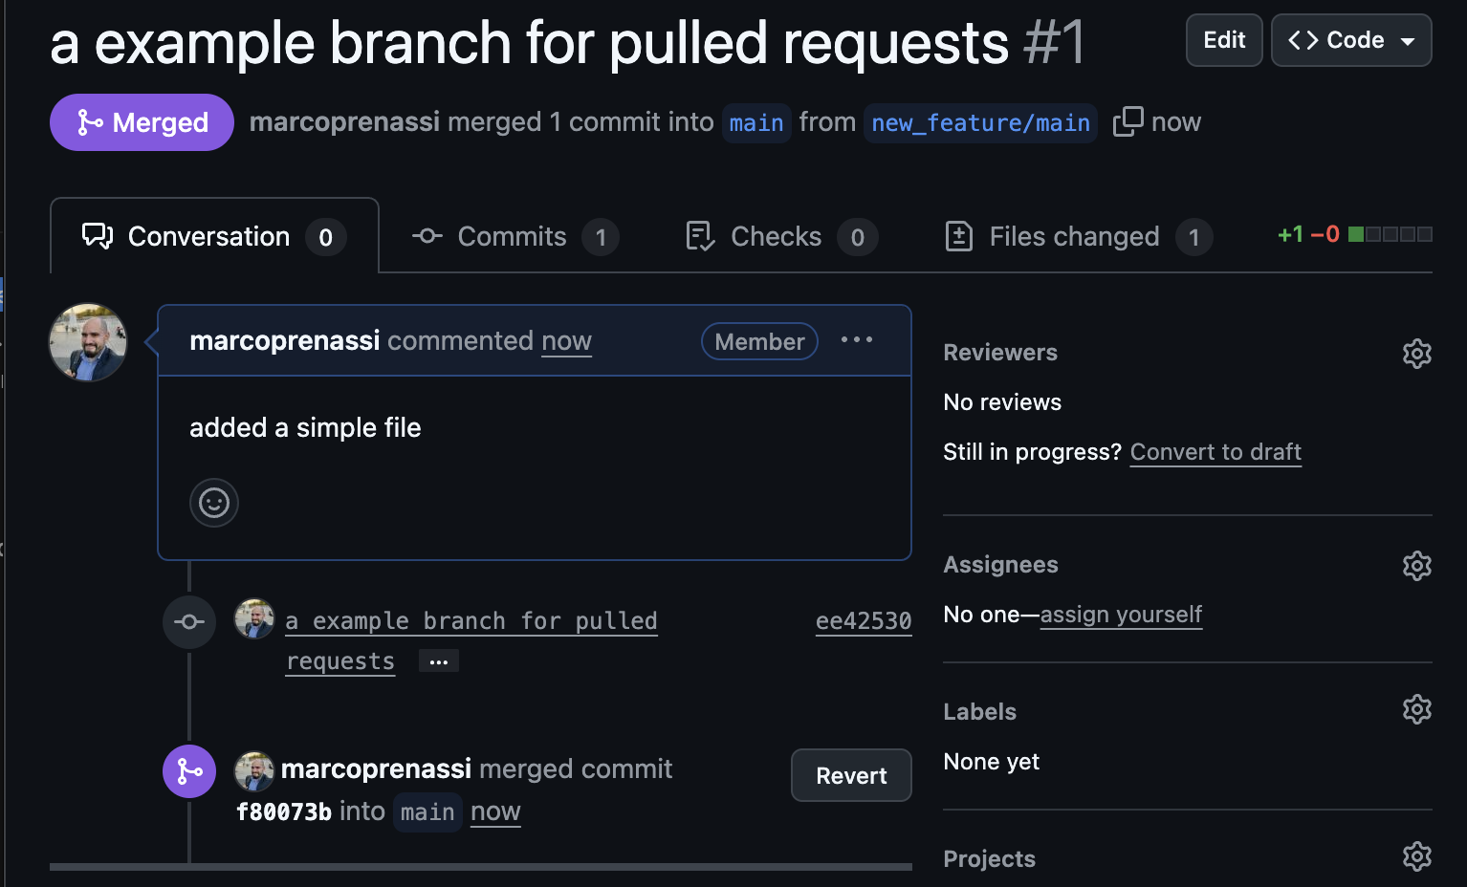
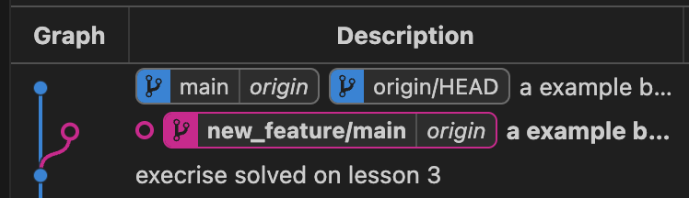
WORKING TOGETHER – GIT PULLING REQUESTS
3. The CODE MANTAINER (e.g., the team leader) check, approve and merge the Pull Request
1
2
3

Slide 40
Try and Fail by design: Exceptions
Exceptions in Python
python stops execution when something unexpected happens,
like a missing file, wrong type, or division by zero.
Sometime, the unexpected is expected, and we need to manage this uncertainty in clean and orderly way.
try:
with open("data.txt", "r") as f:
content = f.read()
print(content)
except FileNotFoundError:
print("file not found")
except Exception as e:
print(f"unexpected error: {e}")
This is DANGEROUS
Don’t be afraid to crash

Slide 41
Thank you

